Slide 1


The Global Lounge
Connection

Slide 2
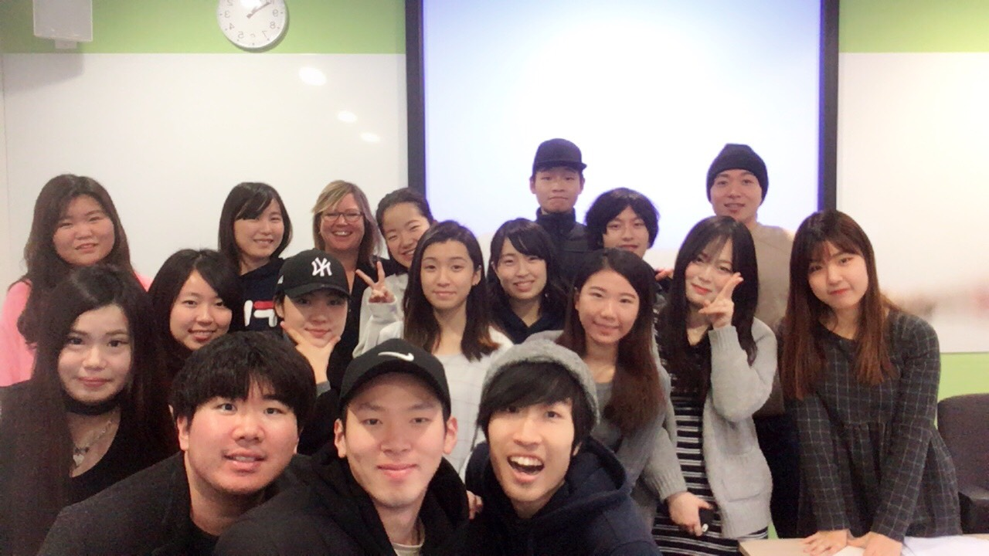

Slide 3

What is the Global Lounge?
A central location where employees and students can integrate and share their language, knowledge and cultural experiences
A meeting place for students
A place to celebrate cultural diversity on campus
A means to making the cultural diversity on campus visual
A place where there are no language barriers
A place to connect as a campus

Slide 4


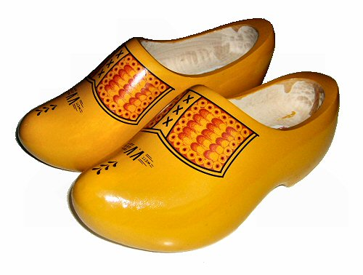
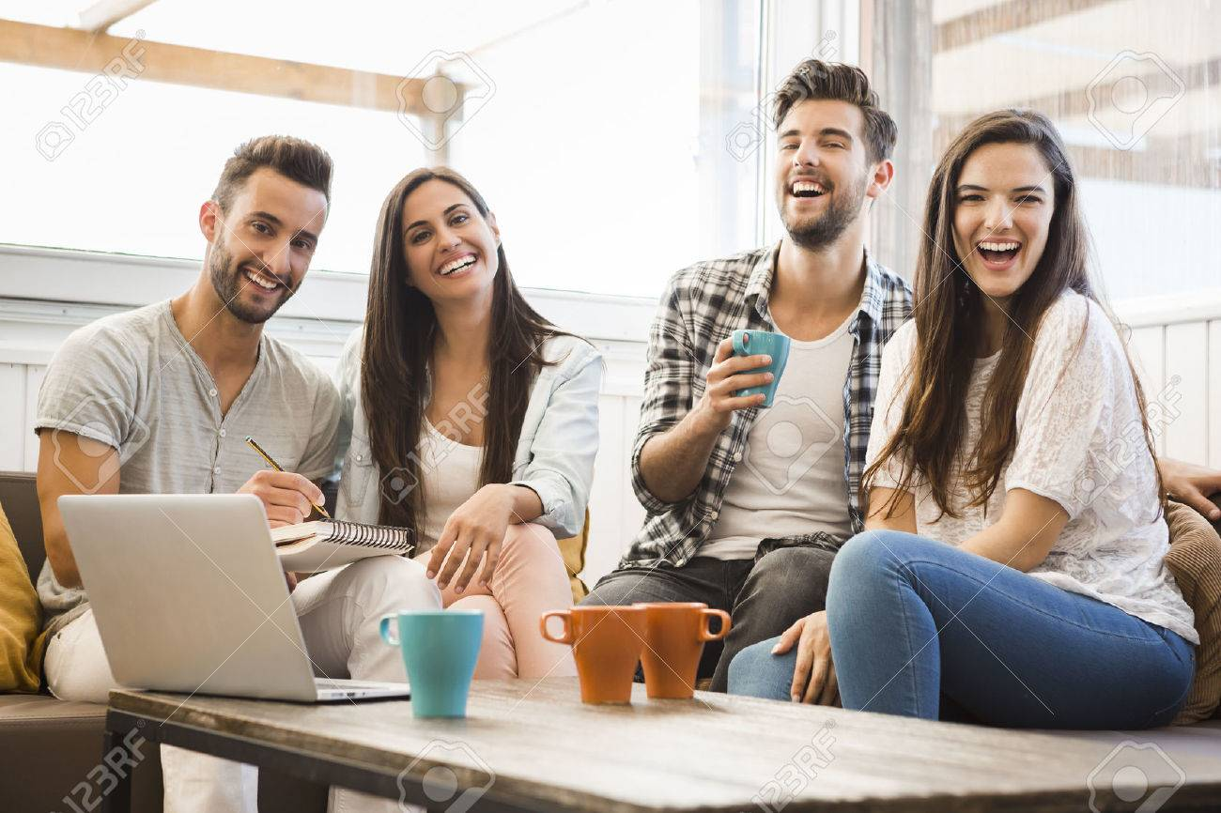

Opportunities
Virtual/physical Lounge
Offer your own cultural event
Attend cultural/social events planned by others
A meeting place – international friendships
MSA events
Coffee time

Slide 5




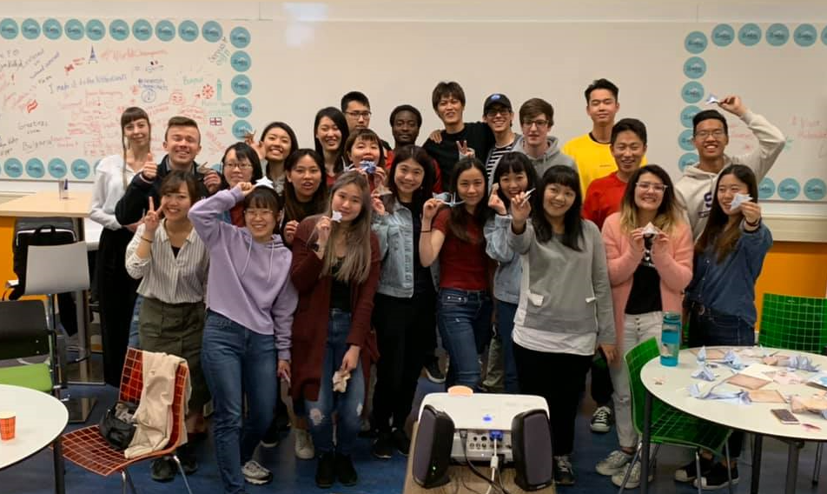

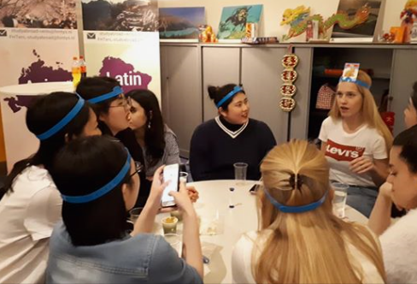


Cultural/social events

Slide 6

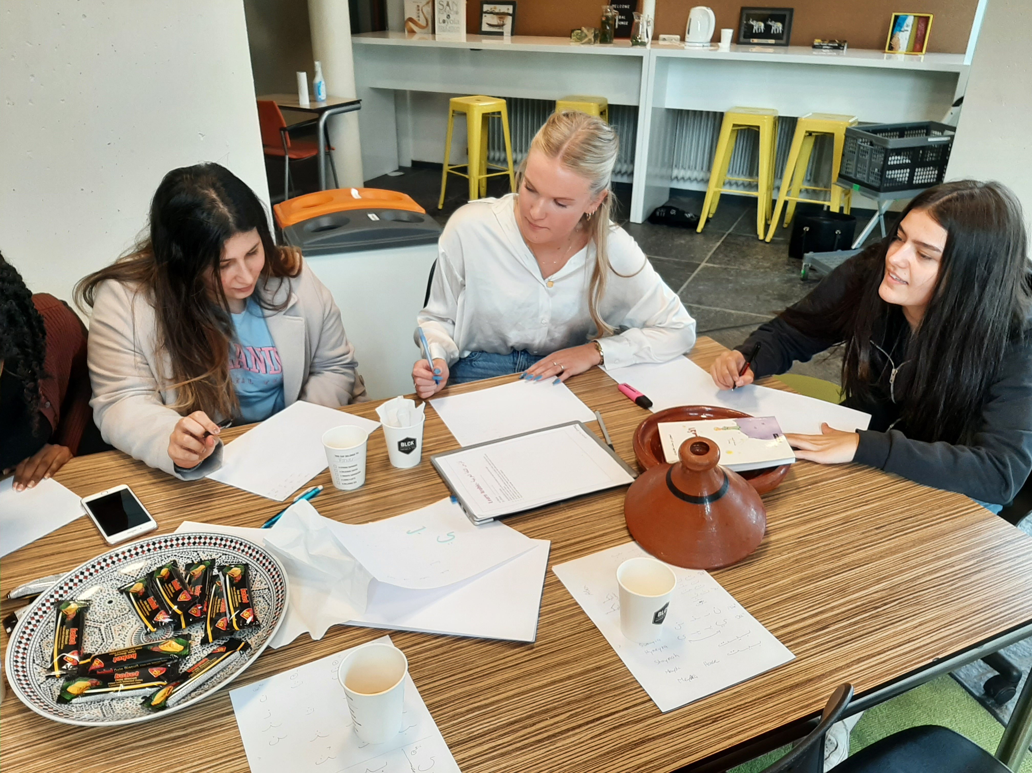
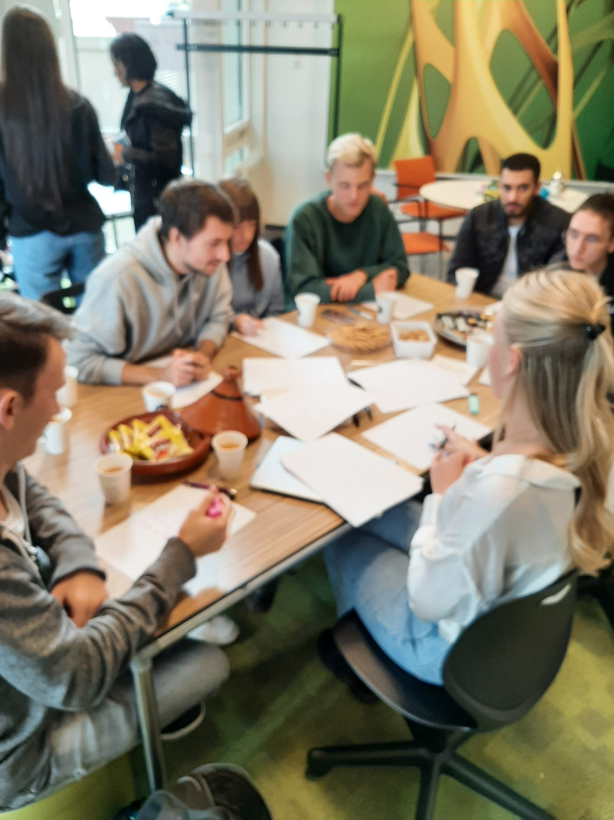
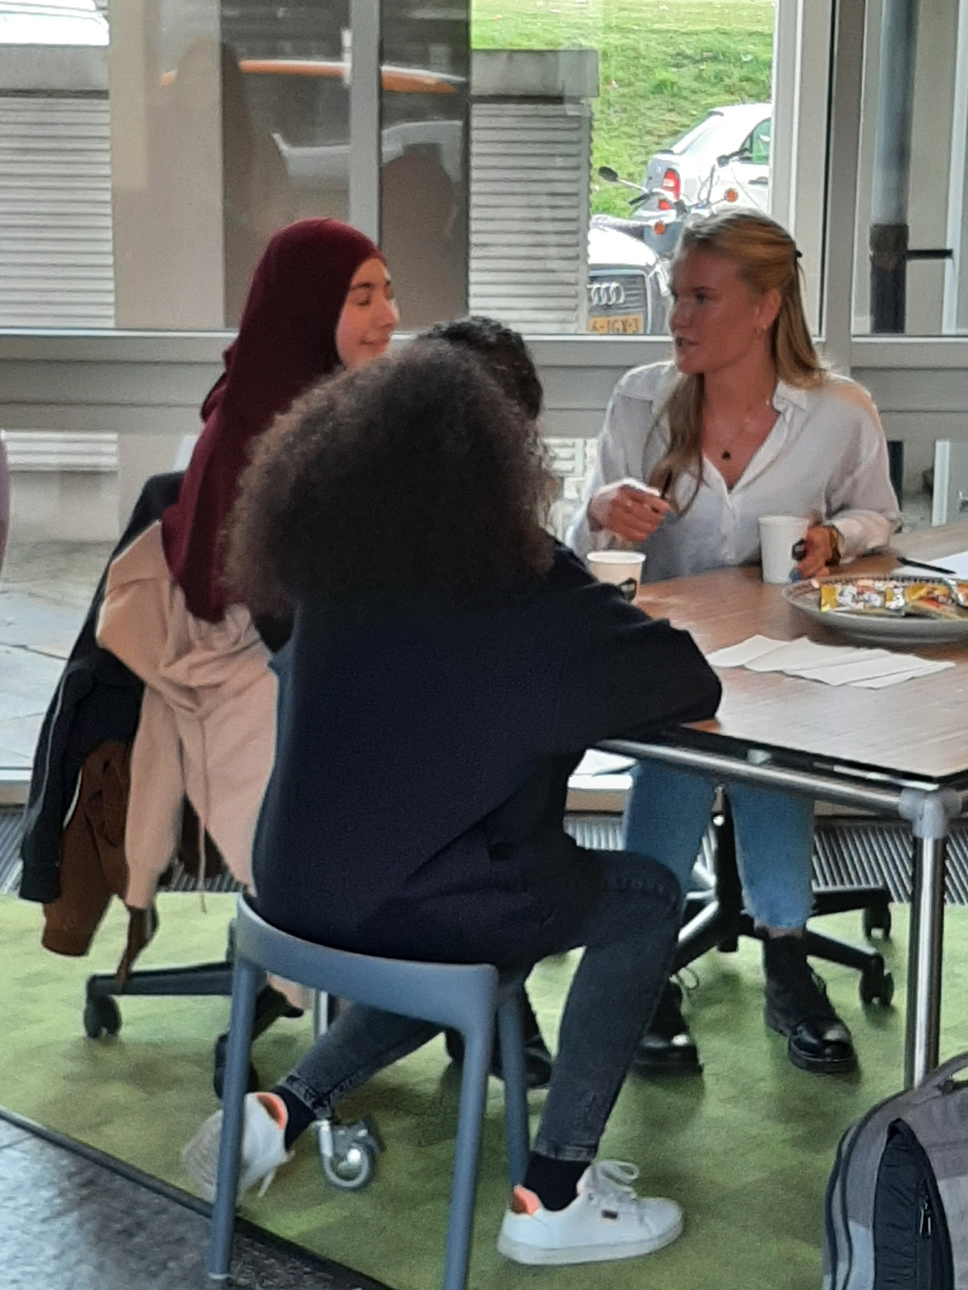

Slide 7
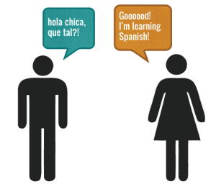
The Language Tandem
globallounge@fontys.nl
You can sign up today!!!!

Slide 8
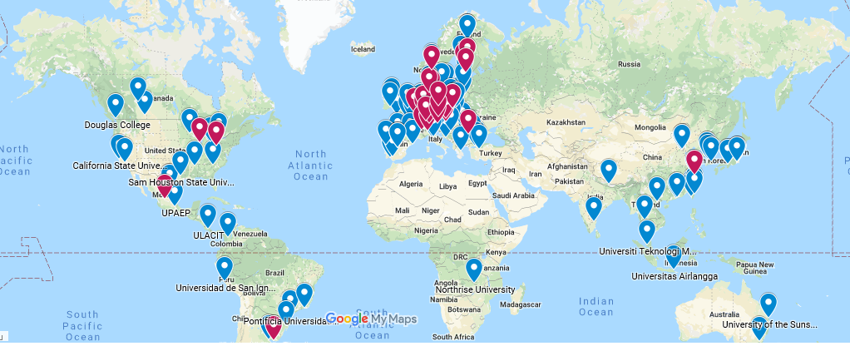
MSA events/Partner University visits

Slide 9








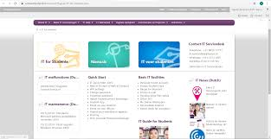

Staying connected

Slide 10
Challenges
New intake of students each semester
      Raise awareness
      GL Management team
Reaching students outside of the exchange group
Campus red tape – events
Student/colleague participation
Collaboration with student associations
Online environment

Slide 11
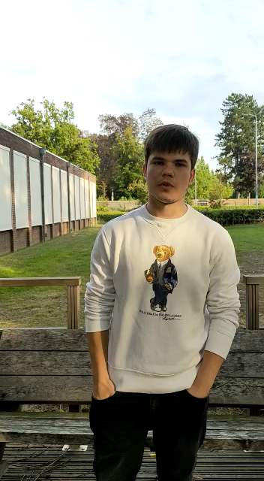
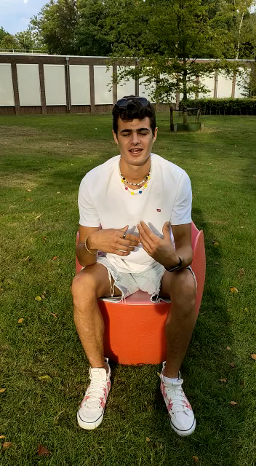
Experience

Slide 12

The good
The bad
The ugly
?????

